Slide 1
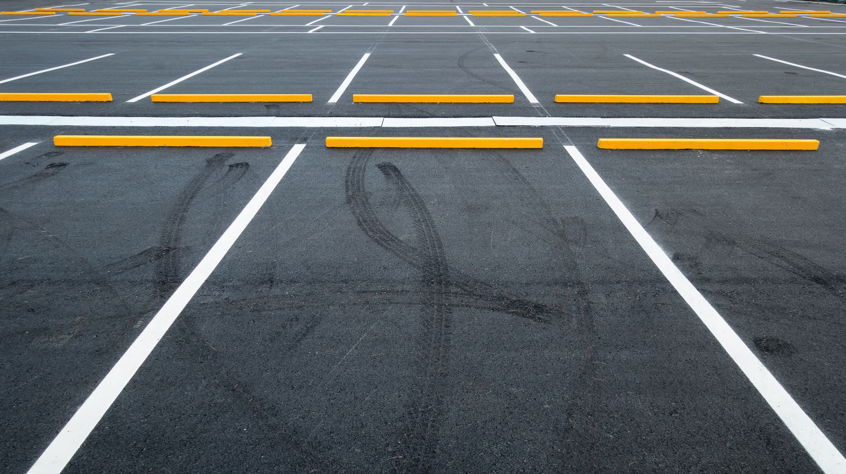
University of Utah Parking System
IS 6640 Web Applications | Team 5 Group Project | Sai Suhrut Sala and Philip B. Raymond

Slide 2
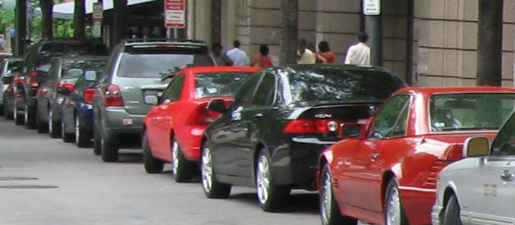
About the Project
Parking Usage Needs:
Monitor Parking
Manage Permits/Violations
Track Drivers

Slide 3
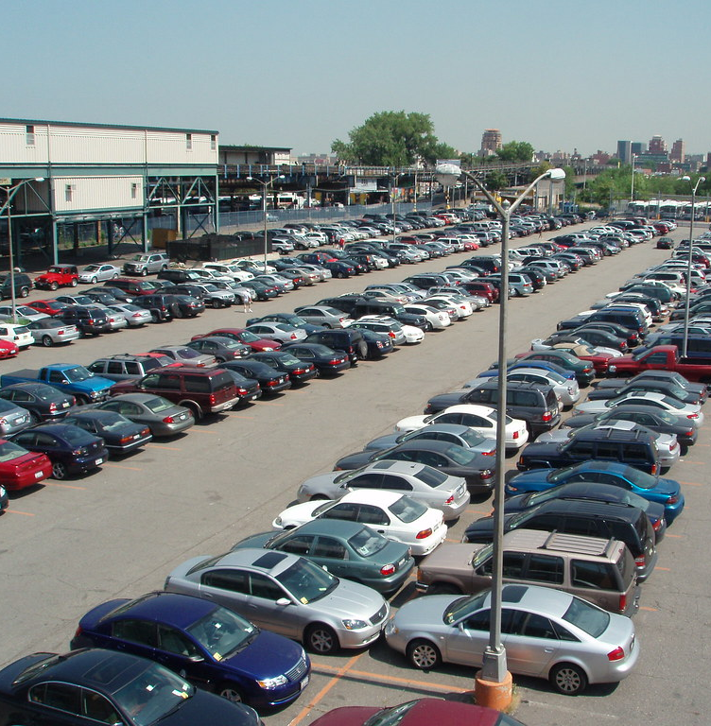
Project Proposal
Scope of Work
Parking Lot/Stall Management discarded
Centered toward drivers, permits, and violations
Strategies for Success
Communication
Project Plan
Member Responsibilities
Ethics

Slide 4
The System

Slide 5
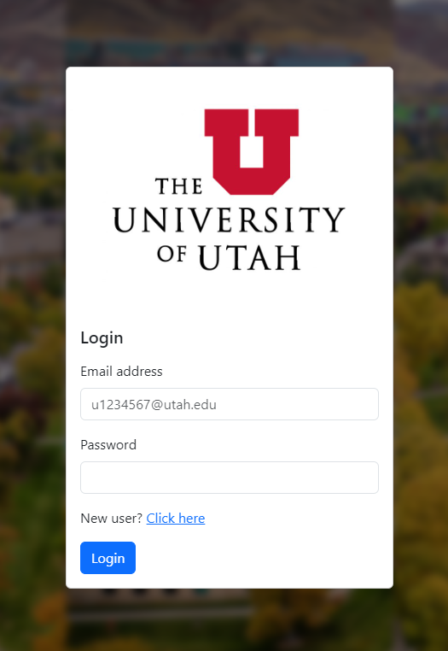
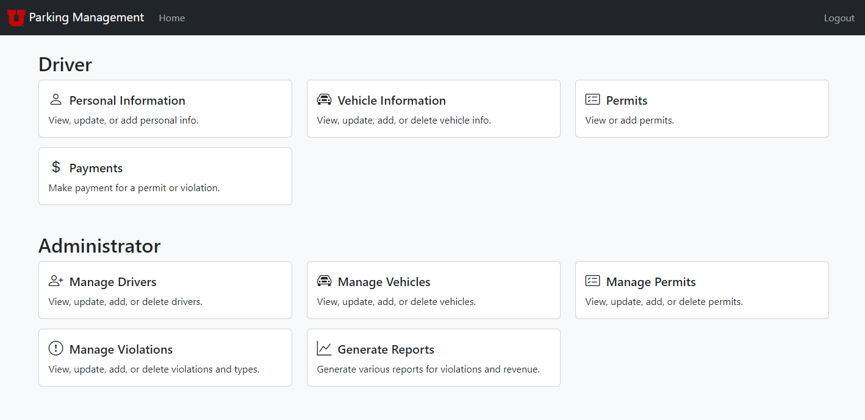
Login
Home Page

Slide 6
CRUD Use Cases

Slide 7
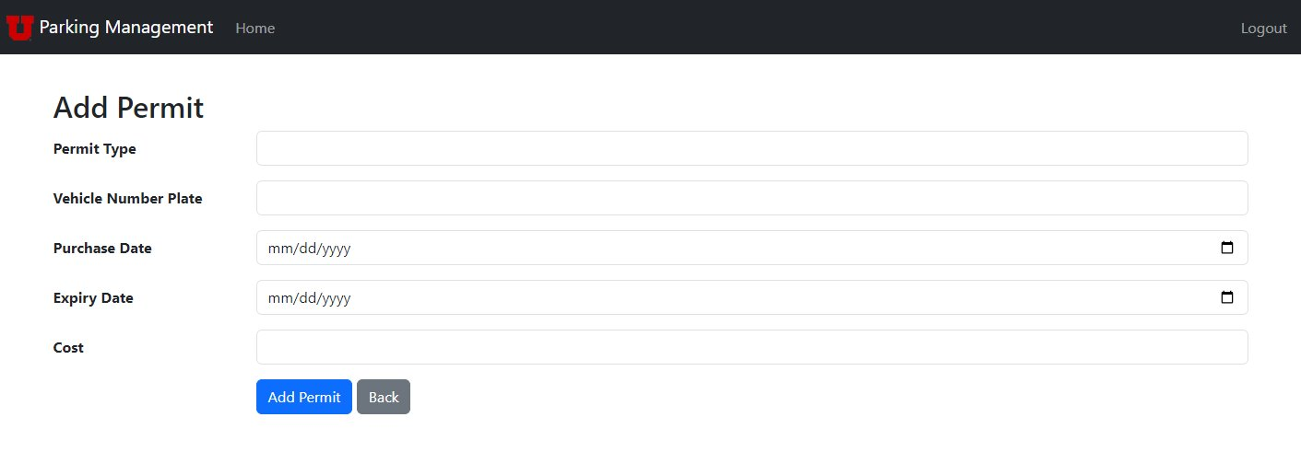
CRUD - Create

Slide 8
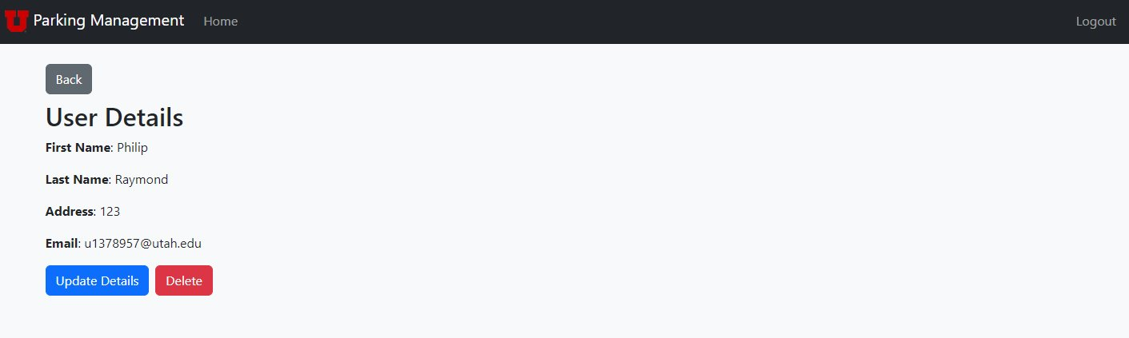
CRUD - Read

Slide 9
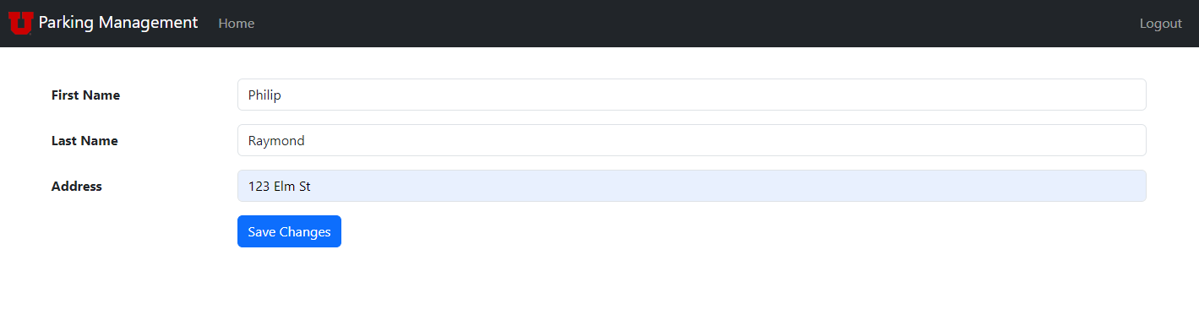
CRUD - Update

Slide 10
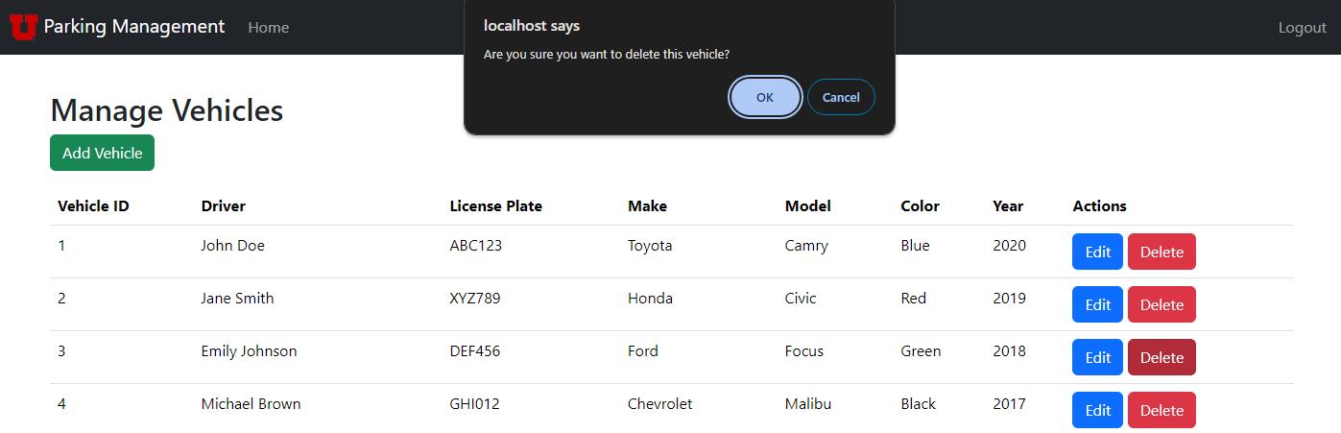
CRUD - Delete

Slide 11
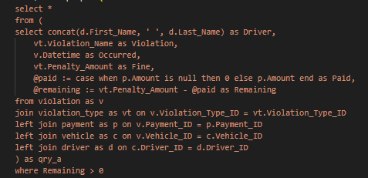
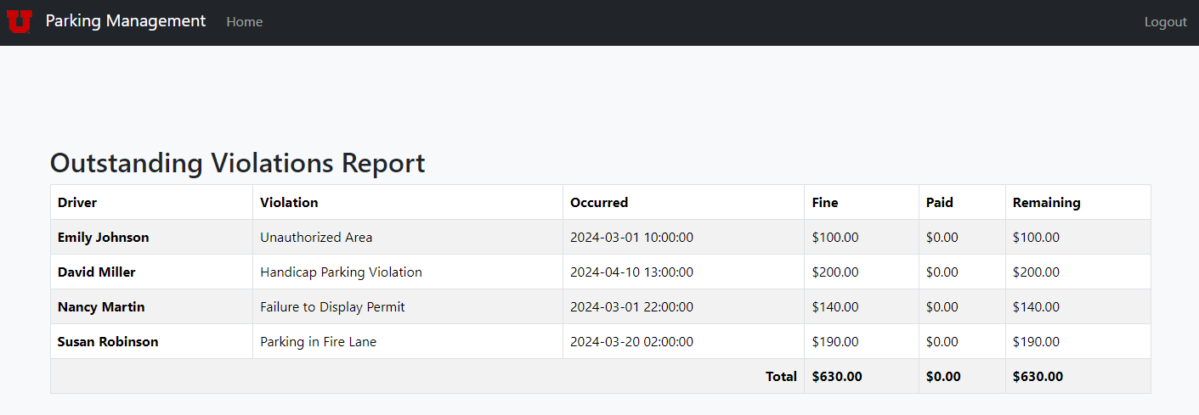
Joins

Slide 12
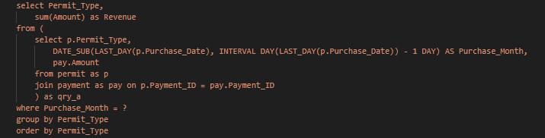
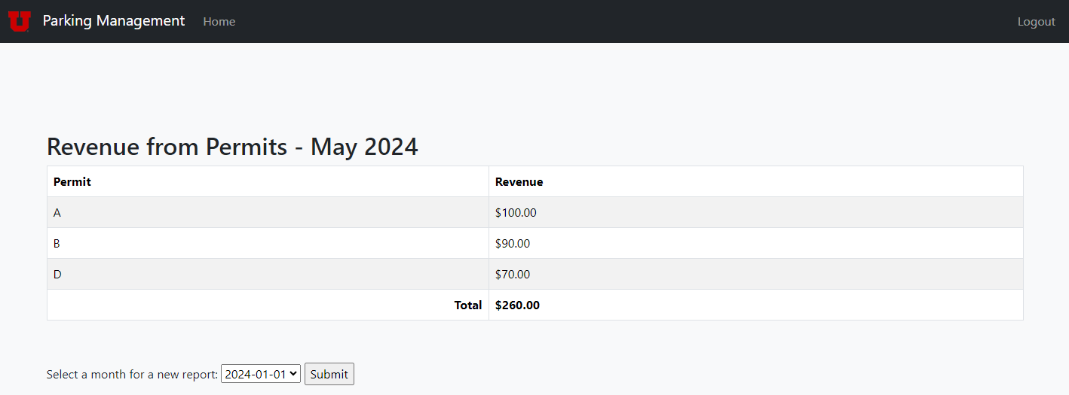
Joins

Slide 13
Demonstration

Slide 14
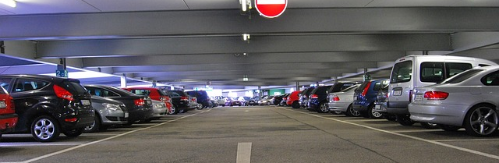
Ethics
Deceptive Practices
Ease of Use
Simple, Clean, and Efficient Pages

Slide 15
Thanks

